Slide 1
Pothole detection using
Deep Learning
and Alert System
UNDER THE GUIDANCE OF
Presented by :-
Arup Sarkar
Jackson Narzari
John Kenedy Toppo
Ms. Tania Sarkar
Assistant Professor
Dept. of Computer Science & Engineering

Slide 2

CONTENTS
01
INTRODUCTION
02
PROBLEM STATEMENT
03
AIM OF THE PROJECT
04
MOTIVATION
05
LITERATURE SURVEY
06
METHODOLOGY
07
SYSTEM FLOW & ARCHITECTURE
08
IMPLEMENTATION & RESULTS
09
CONCLUSION & FUTURE WORKS
10
REFERENCES

Slide 3
Introduction
Our project aims to develop a system that detects potholes on roads using Deep learning and warns drivers before they approach the pothole, ensuring a safer and more comfortable driving experience.
Potholes are a major concern for road safety, causing accidents, vehicle damage, and discomfort to drivers. This project addresses the need for an efficient and effective pothole detection system, enabling authorities to prioritize road maintenance and repair.

Slide 4
PROBLEM STATEMENT
Current pothole detection models lack an integrated alert system to notify users about approaching potholes on a map from a distance. Existing models can detect potholes only within a certain range and do not incorporate map-based alert systems.

Slide 5
AIM OF THE PROJECT
Primary Objective: Create a system capable of accurately detecting potholes using Deep learning techniques.
Coordinate Marking: Identify and mark the geographical coordinates of detected potholes for accurate localization.

Slide 6
AIM OF THE PROJECT
Integrate with Mobile Application: Develop an integrated mobile application that allows users to view pothole locations on a map and receive timely alerts.
User Alert/Notification: Warn users through notifications when they are approaching 100 meters before the pothole, enhancing road safety and reducing vehicle damage.

Slide 7
MOTIVATION
Increasing Road Accidents
Statistics: Potholes caused over 3,564 accidents and 1,397 deaths in India in 2022.
Safety Concerns: Poor road conditions, including potholes, significantly contribute to road accidents in India.
Vehicle Damage
Financial Impact: Drivers spend approximately INR 20,000 crore annually on vehicle repairs due to poor road conditions.
Maintenance Issues: Frequent and costly vehicle maintenance due to potholes.

Slide 8
MOTIVATION
Travel Disruptions: Potholes cause traffic slowdowns, detours, and congestion.
Time Loss: Significant time wasted due to vehicle repairs and poor road conditions.

Slide 9
LITERATURE SURVEY
Author | Year | Paper Name | Area Focused | Limitation
Christian Koch ª, Ioannis Brilakis ^{b} ¹ | 2011 | Pothole detection in asphalt pavement images | Pavement assessment, Pothole detection, Visual sensing, Image processing | relies on normal lighting
Mohan Prakash B & Sriharipriya K.C | 2022 | Enhanced pothole detection system using YOLOX algorithm | Detecting Potholes | Detection of cracks in roads are not addressed
Kiran Kumar Vupparaboina, Roopak R. Tamboli | 2015 | Laser-based Detection and Depth Estimation of Dry and Water-Filled Potholes | Depth Estimation | Very expensive

Slide 10
LITERATURE SURVEY
Sensor-Based Detection:
Uses data from sensors like accelerometers and gyroscopes.
Advantages: Cost-effective, leverages existing smartphone sensors.
Disadvantages: Data can be noisy, accuracy issues.
Image-Based Detection:
Utilizes computer vision algorithms on road images.
Advantages: Visual verification, high accuracy with good data.
Disadvantages: High computational resources, challenging in poor lighting or weather conditions.

Slide 11
LITERATURE SURVEY
Machine Learning-Based Detection:
Employs machine learning models trained on diverse datasets.
Advantages: Can learn complex patterns, adaptable.
Disadvantages: Requires large amounts of labeled data, computationally intensive.

Slide 12
Our Approach
Combining the strengths of sensor-based and Deep learning techniques.
Developing a real-time notification system.
Aiming for a scalable and efficient solution to enhance road safety.

Slide 13
METHODOLOGY
1. Data Collection:
- Pothole Data: Collected from Kaggle and Roboflow.
- Sensor Data: Utilized GPS module to collect coordinates of the pothole.
2. Dataset Size: 30000+ Images of both pothole and normal roads.
3. Data Preprocessing:
- Image Data Generator Configuration: An Image Data Generator object is created with specified augmentation parameters such as rotation range, width and height shift ranges, zoom range, horizontal flipping, and brightness range.
- Train and Validation Data Loading: Training and validation data are loaded using the flow_from_directory method of Image Data Generator. The images are resized to 256x256 pixels, converted into batches of size 128, and their labels are one-hot encoded.
- Augmentation: During training, the images are augmented using the parameters specified in Image Data Generator, which helps in increasing the diversity of the dataset and improving model generalization.

Slide 14
METHODOLOGY
3. Model Development:
- Deep Learning: Used Convolutional Neural Networks (CNNs) for image-based detection.
- Training: Trained models using preprocessed datasets and validated with test data to ensure accuracy.
4. Mobile Application Development:
- Platform: Developed an Android application.
- User Interface: Designed a user-friendly interface for displaying pothole locations and notifications.
5. Real-Time Notification System:
- Geofencing: Implemented to detect user approach towards potholes.
- Alerts: Sent notifications to users when within 100 meters of a pothole.
6. Testing and Validation:
- Field Testing: Conducted a field tests to validate detection and notification systems.

Slide 15
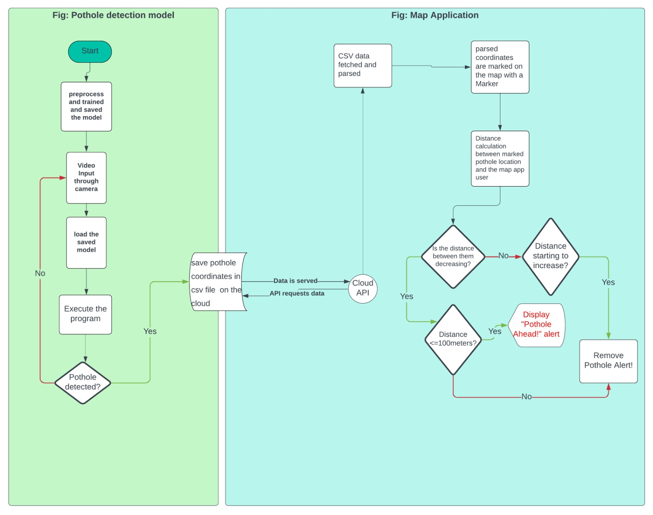
SYSTEM FLOW and ARCHITECTURE

Slide 16
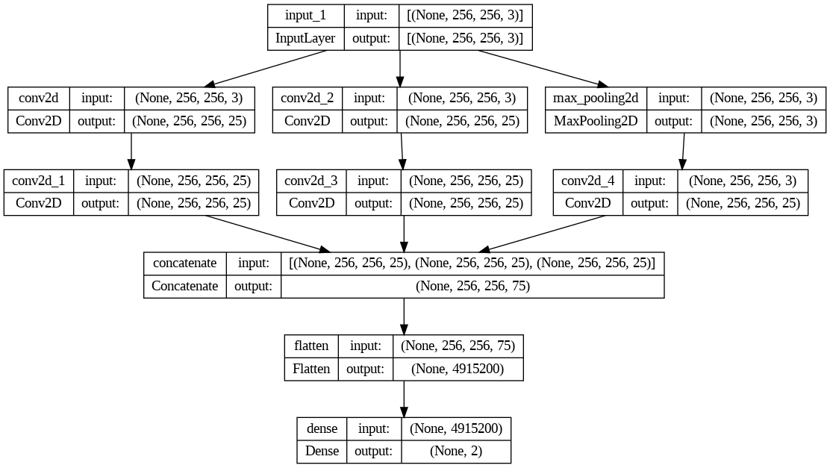
SYSTEM FLOW and ARCHITECTURE
Image Input
Pothole/Normal

Slide 17
IMPLEMENTATION and RESULTS
Development Tools: Used Android Studio for app development, TensorFlow for model training, and OpenCV for image processing.
User Interface Design: Developed a simple UI for users to view pothole locations and receive notifications.

Slide 18
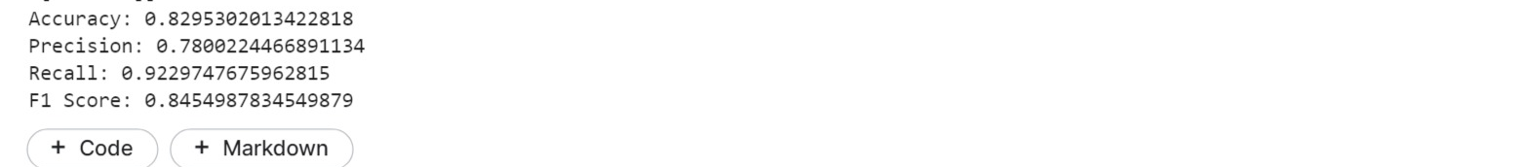
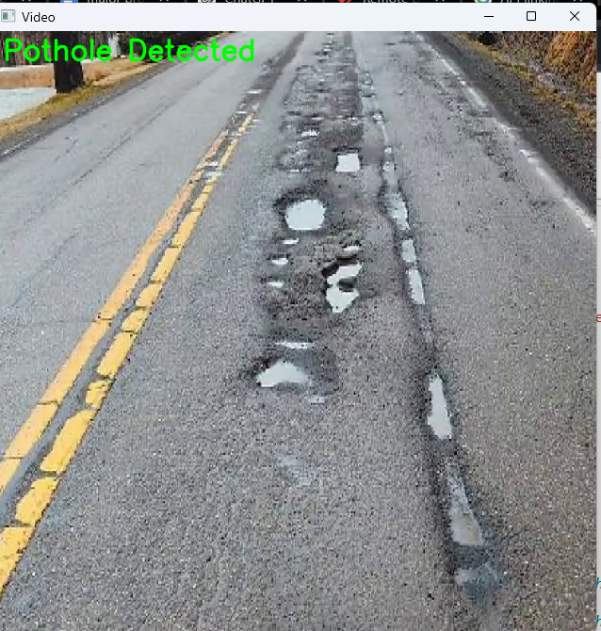
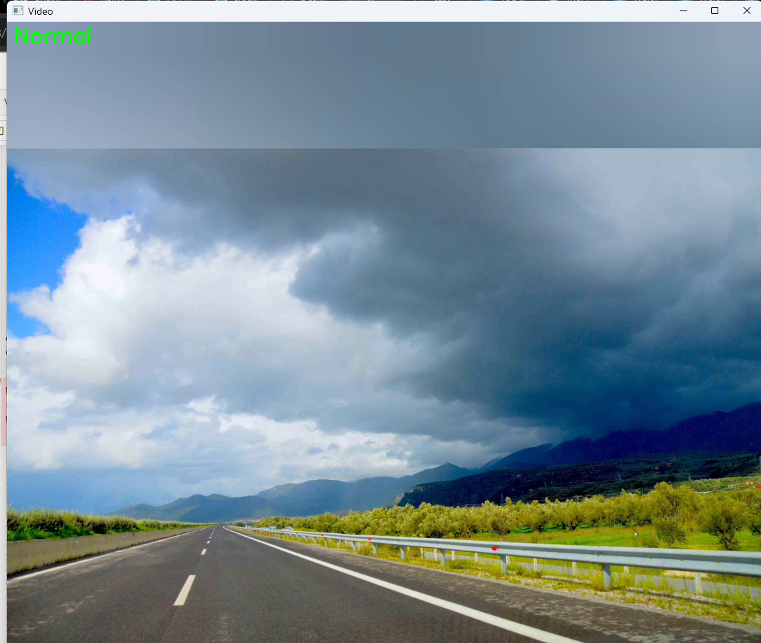
IMPLEMENTATION and RESULTS
Detection Accuracy: Achieved an accuracy rate of 80% in detecting potholes from collected data.
Testing The Model:

Slide 19
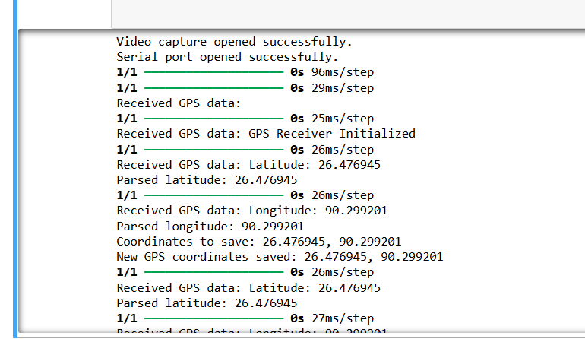
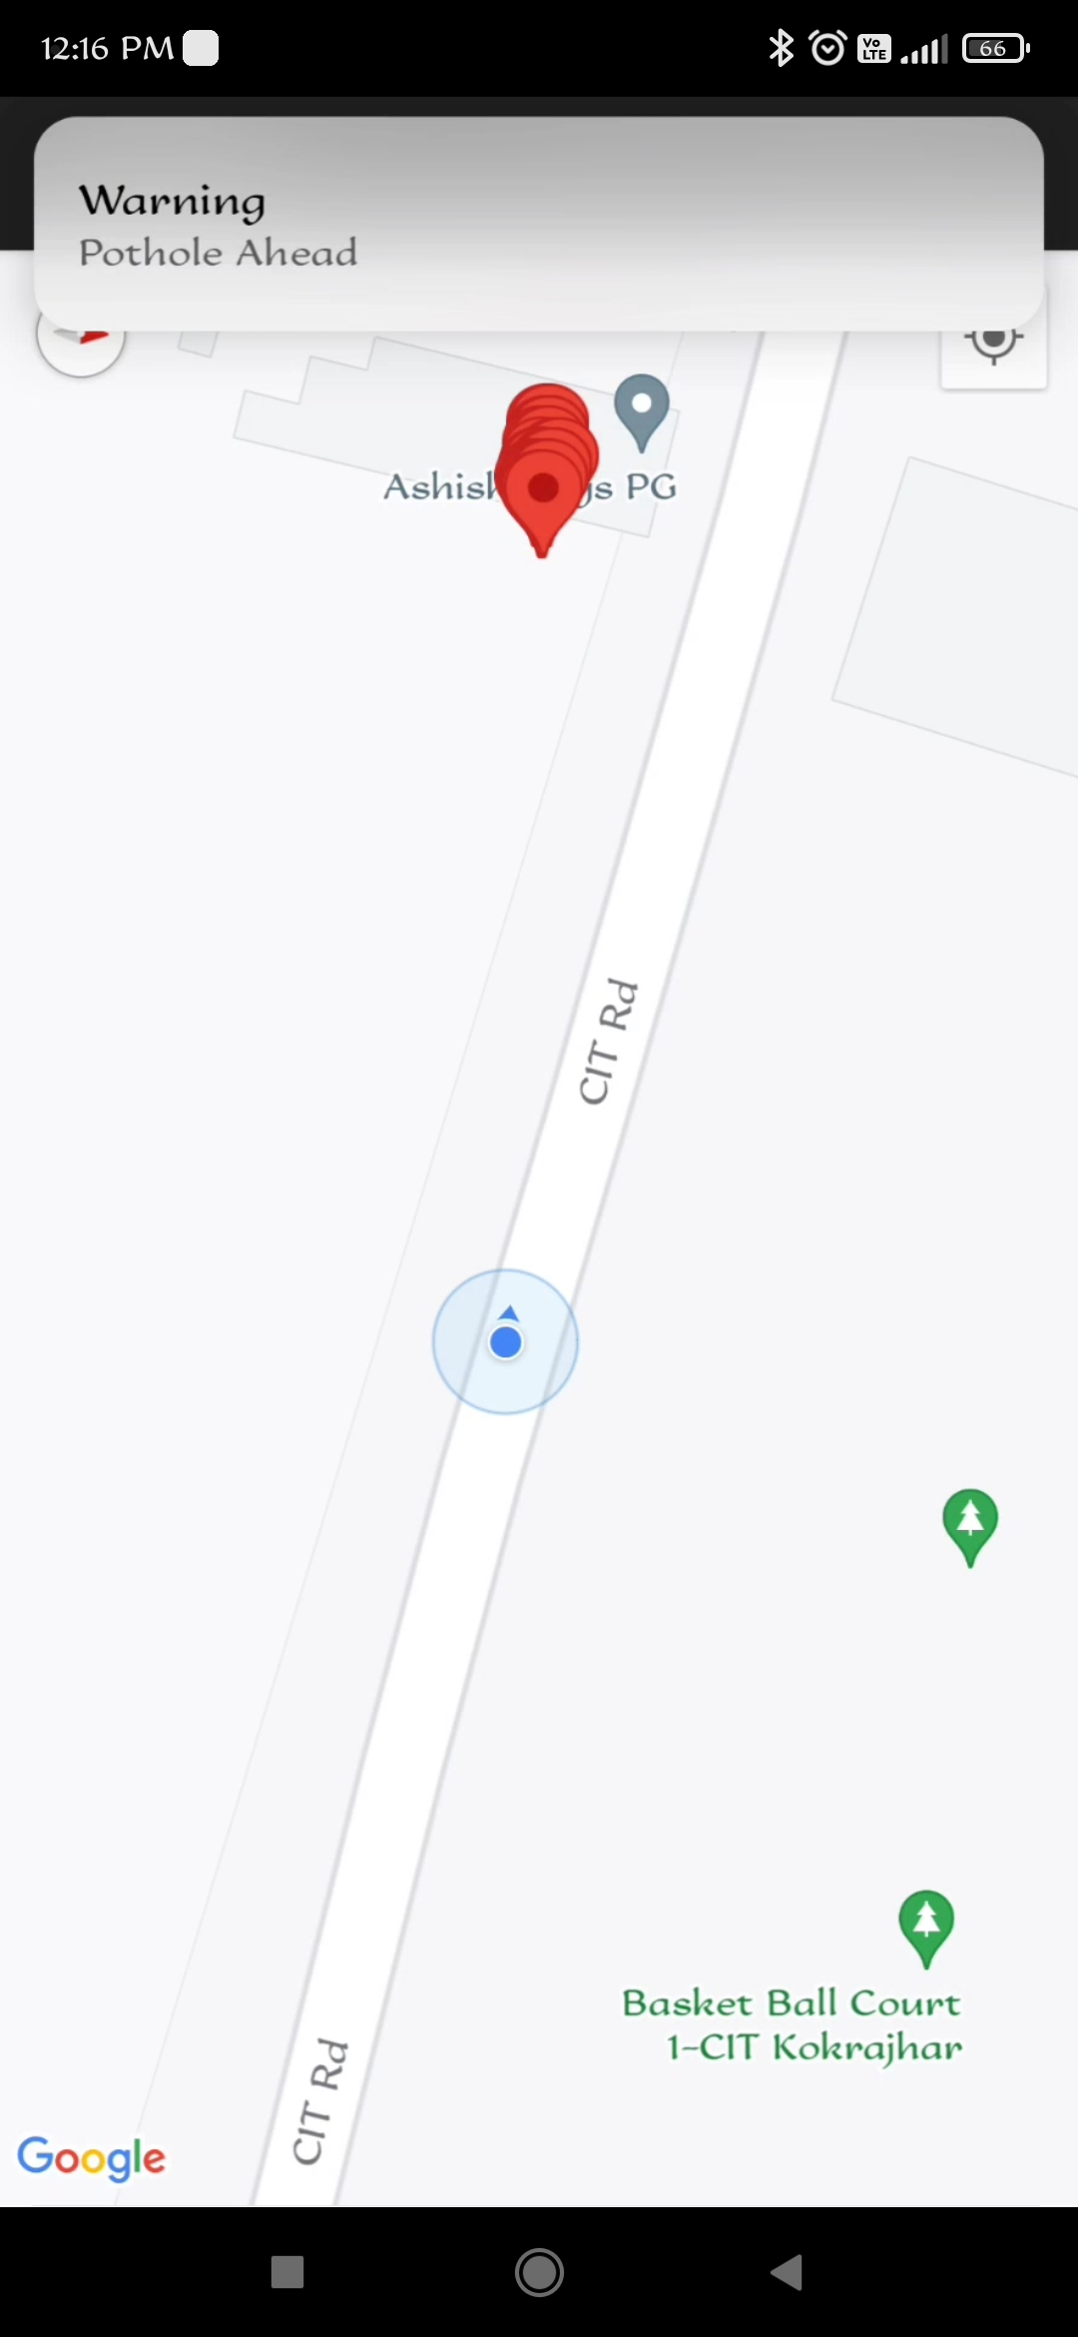
IMPLEMENTATION and RESULTS
Alert Notifications: Successfully implemented a notification system alerting users within 100 meters of a detected pothole.
Storing Pothole GPS Coordinates:
Pothole Location
User Location

Slide 20
CONCLUSION and FUTURE WORKS
Our project successfully developed a solution for detecting and managing potholes using Deep learning. By integrating the detection model with a mobile app to notify when approaching a pothole within 100 meters . This system enhances road safety, reduces vehicle damage, and improves commuter convenience by providing timely warnings and mitigating travel disruptions.
Future work will focus on improving model accuracy, expanding geographic coverage, integrating with navigation apps, and exploring predictive maintenance strategies to address road issues proactively. Through these advancements, we aim to significantly enhance road safety and infrastructure maintenance.

Slide 21
REFERENCES
[1] Christian Koch, Ioannis Brilakis,Pothole detection in asphalt pavement images,
https://www.sciencedirect.com/science/article/pii/S1474034611000036?ref=pdf_download&fr=RR-2&rr=836f633b4d809371
[2] Basavaraj Jakkali Associate Professor, Dept. of CSE, BMS college of Engg, Bangalore, Speed Breaker and Potholes Mapping
https://www.academia.edu/40510103/Speed_Breaker_and_Pothole_Mapping
[3] Abhishek Kumar, Chakrapani, Dhruva Jyoti kalita, Vibhab Prakash Singh, A modern pothole detection technique using Deep Learning.
https://sci-hub.hkvisa.net/10.1109/IDEA49133.2020.9170705
[4] J, Dharneeshkar; V, Soban Dhakshana; S A, Aniruthan; R, Karthika; Parameswaran, Latha, Deep Learning based Detection of potholes in Indian roads using YOLO.
https://sci-hub.hkvisa.net/10.1109/ICICT48043.2020.9112424
[5] Ping, Ping, Yang, Xiaohui, Gao, Zeyu. A Deep Learning Approach for Street Pothole Detection.
<https://sci-hub.hkvisa.net/10.1109/BigDataService49289.2020.00039>

Slide 22
Thank you

